Slide 1


Detection of Stress in IT Employees Using Machine Learning Techniques
NAME:- Amritpal Kaur Dhillon
UID:- 22Bis80001
Branch:- B.E CSE (IS) (AIT-APEX)
TOPIC:- CAPSTONE PROJECT PPT

Slide 2
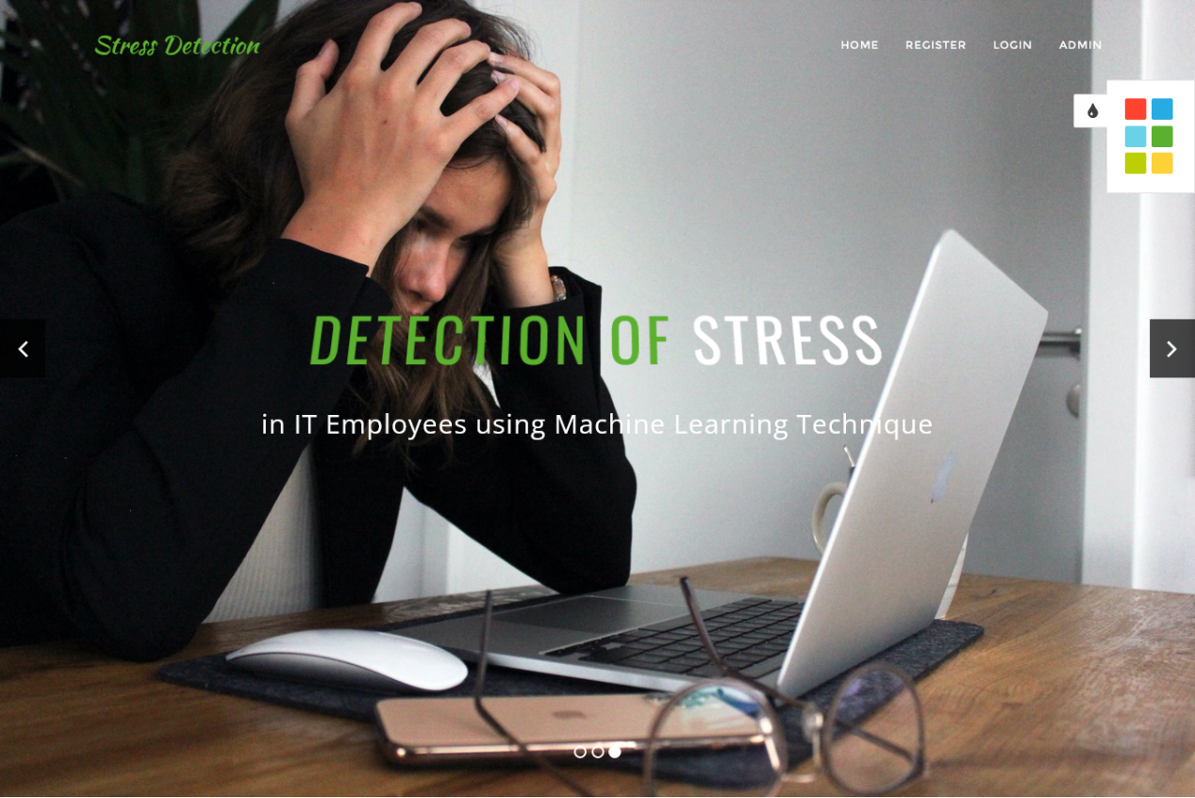

Slide 3


ABSTRACT
My project's primary goal is to identify signs of stress in IT professionals utilizing sophisticated machine learning and image processing methods. Our technology is an improved version of the previous stress detection technologies, which did not take into account the employee's emotions or live detection. However, this system includes both periodic and live employee emotion detection. Automatic detection of stress minimizes the risk of health issues and improves the welfare of the IT employee and the company.

Slide 4

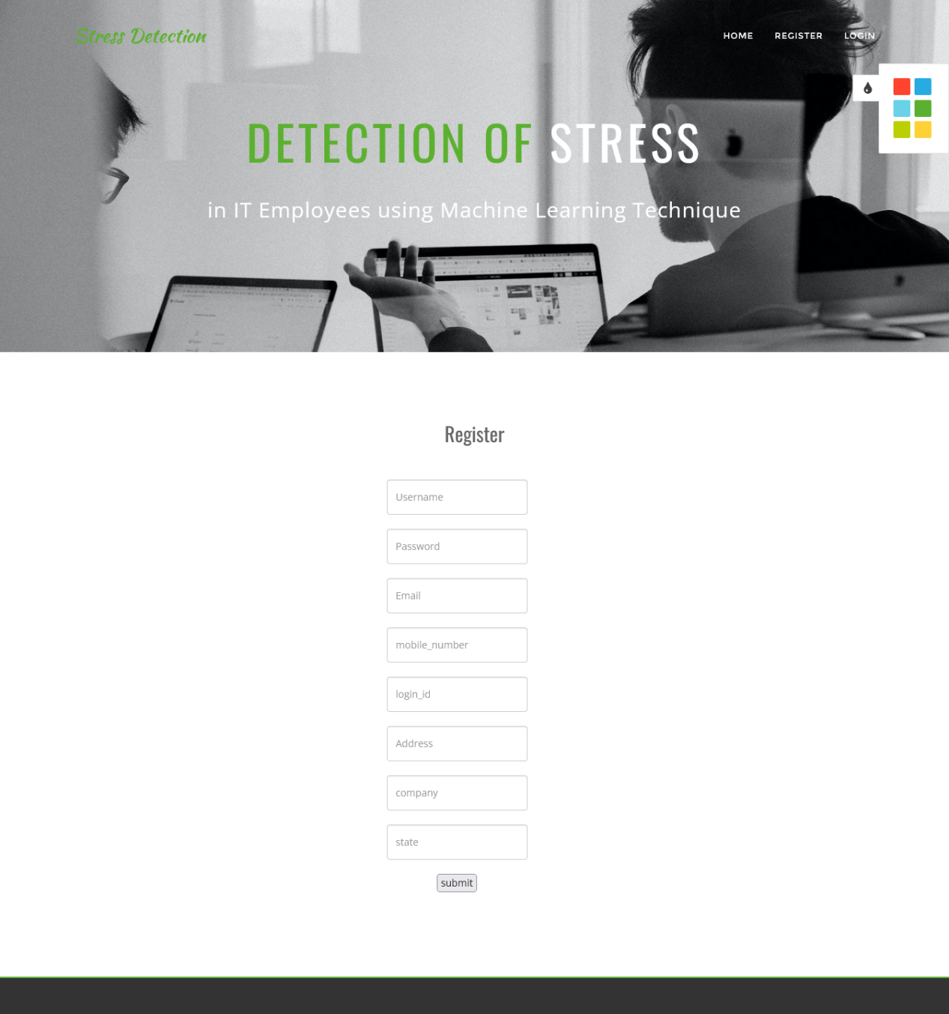


Slide 5

EXISTING SYSTEM
In the existing system work on stress detection is based on digital signal processing, taking into consideration Galvanic skin response, blood volume, pupil dilation, and skin temperature. The other work on this issue is based on several physiological signals and visual features (eye closure, head movement) to monitor the stress in a person while he is working. However, these measurements are intrusive and are less comfortable in real applications. Every sensor data is compared with a stress index which is a threshold value used for detecting the stress level.

Slide 6

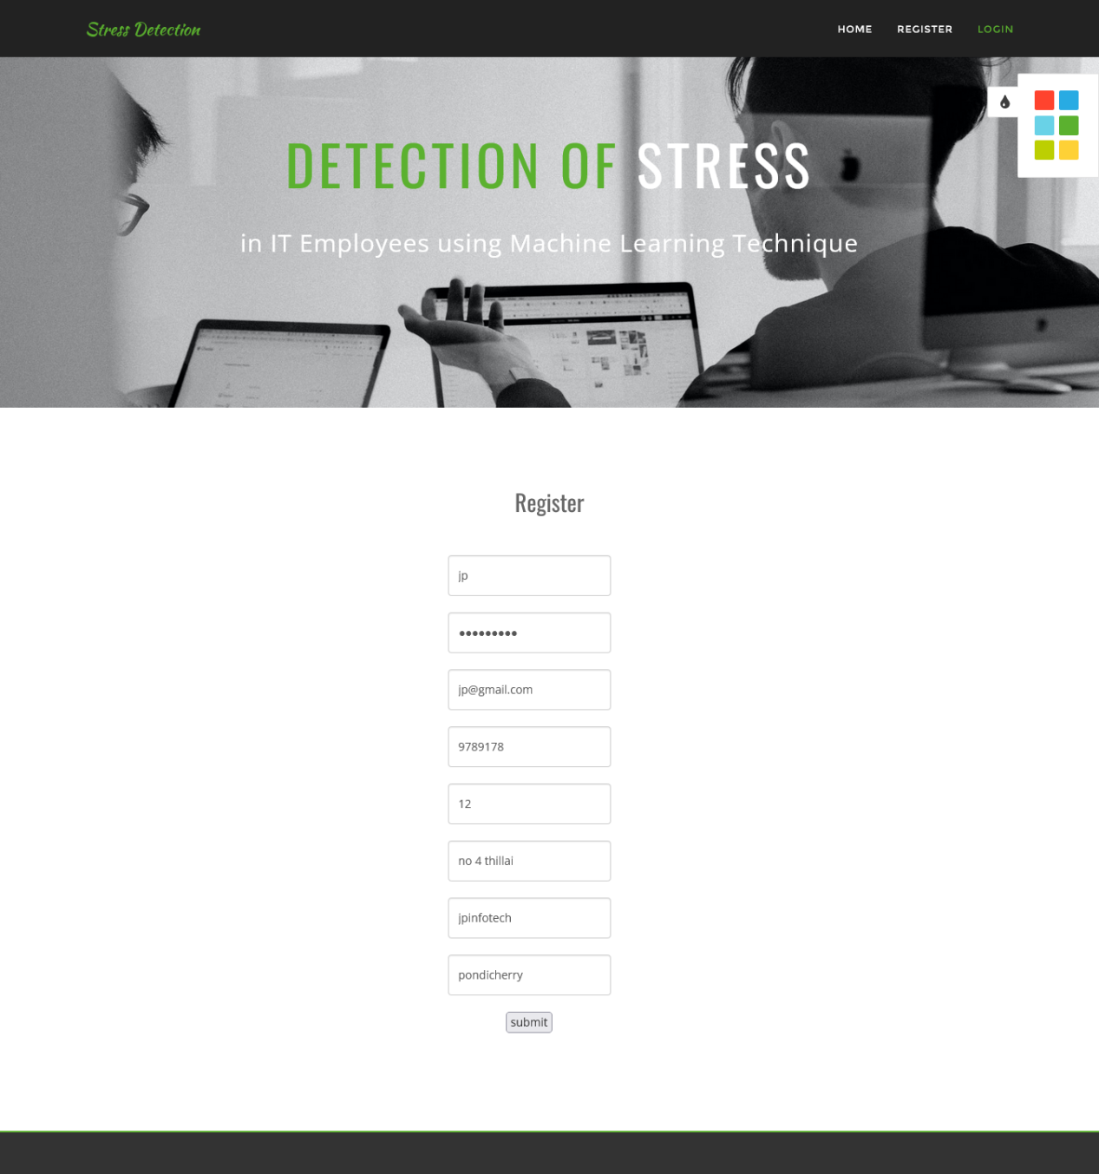

Slide 7

In the existing system the authors used KNN for the experiment. K-Nearest Neighbors algorithm in Machine Learning (or KNN) is one of the most used learning algorithms due to its simplicity.
The existing system which uses KNN is a lazy learning, non-parametric algorithm. It uses data with several classes to predict the classification of the new sample point. KNN is non-parametric since it doesn’t make any assumptions about the data being studied, i.e., the model is distributed from the data.

Slide 8




Slide 9

DISADVANTAGES OF EXISTING SYSTEM
Different people may behave or express differently under stress and it is hard to find a universal pattern to define the stress emotion.
The existing system model does not work well with large datasets as calculating distances between each data instance would be very costly.

Slide 10




Slide 11
The existing system model does not work well with high dimensionality as this will complicate the distance calculating process to calculate the distance for each dimension.
The existing system model is very sensitive to noisy images and missing data.
The existing system model has the problem that the data in the entire dimension should be scaled (normalized and standardized) properly.

Slide 12

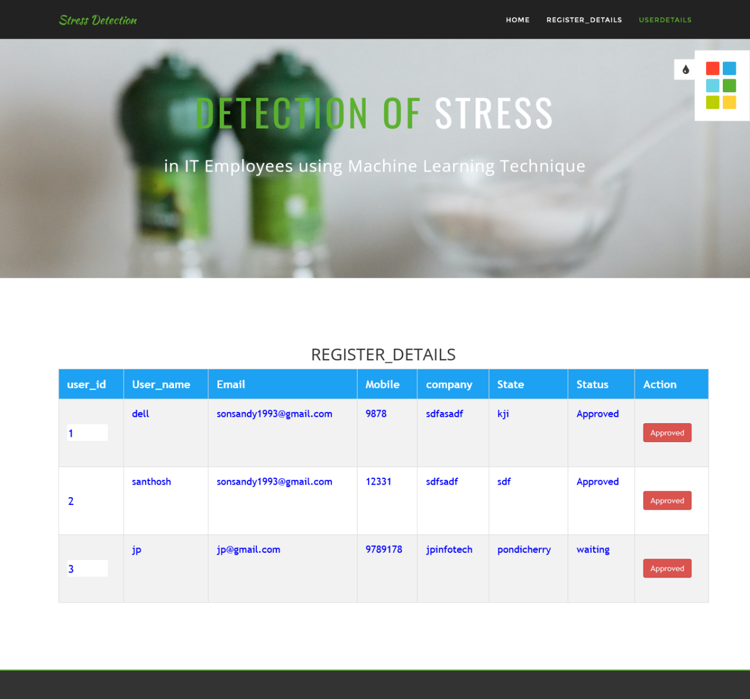


Slide 13


PROPOSED SYSTEM
Our proposed system is an updated version of prior stress detection systems that did not include live analysis or individual employee emotional analysis. Our proposed system model is developed using the CNN Model Architecture. By taking a picture as input and returning characteristics associated with those images as output. We use a bounded box to show the employee’s feelings, and also the emotions are shown at the top of the bounded box. The proposed system uses emotional classes such as: Angry, Disgusted, Fearful, Happy, Neutral, Sad, and Surprised to detect the emotion of the IT employee.

Slide 14



Slide 15

To check the efficiency of the stability, we gathered information and executed a quantitative experimental investigation. Firstly, the User has to register with the required details user name, login ID, password, mobile, email, Locality, Address, city, state, etc. With all the required details user has to register. Users can log in with a registered Login ID and password. The user can successfully log in only if the admin activates that user. If the admin does not activate that user then the user cannot log into the system, this is for the security of maintaining the employees.

Slide 16
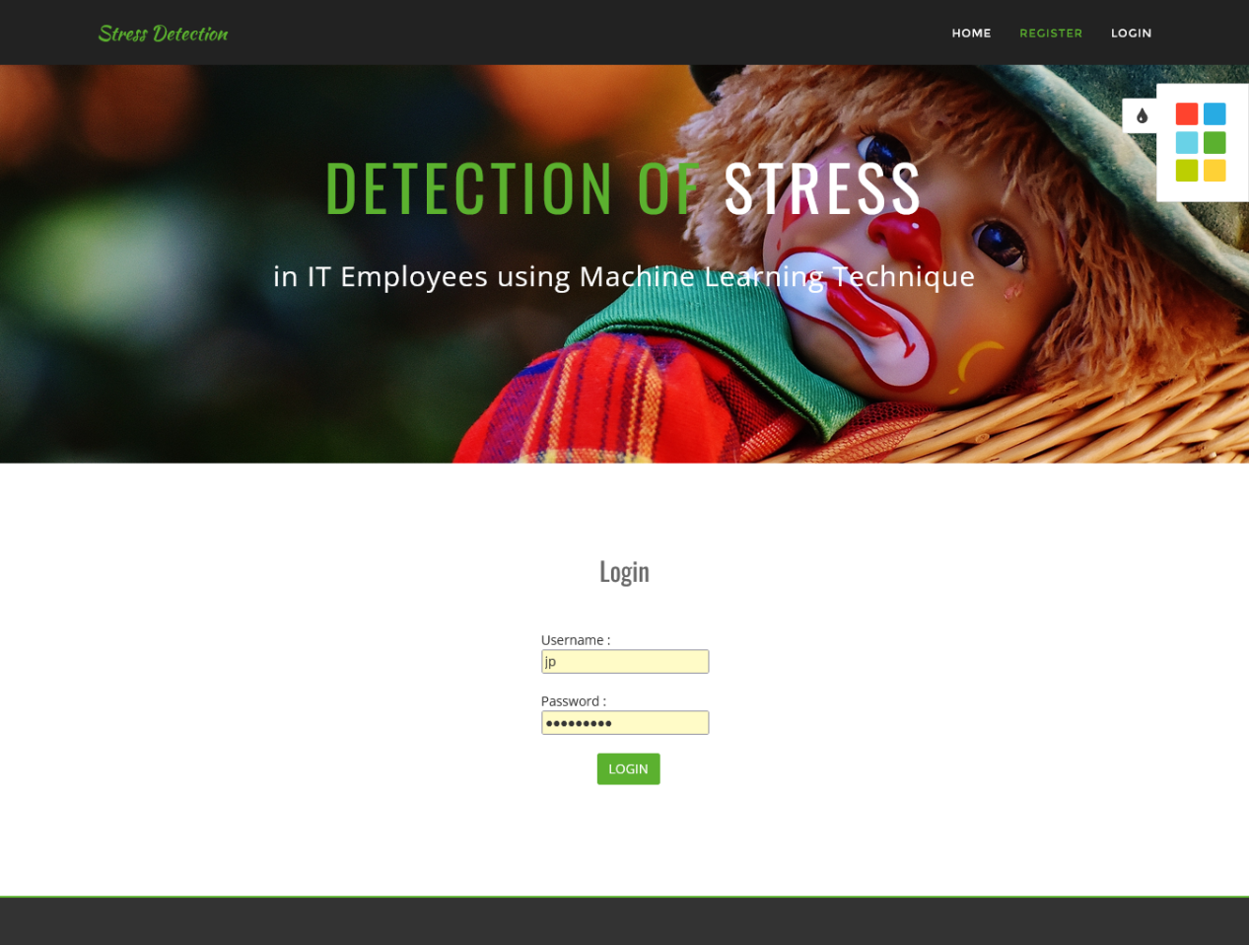

Slide 17
If the user clicks on the live cam then the camera turns on and monitors the face of a person who is in front of the camera and displays the result. The user needs to upload their image. The admin will see the predicted results on the admin page. The admin has the option of seeing the performance analysis parameters and their graphical representations.

Slide 18
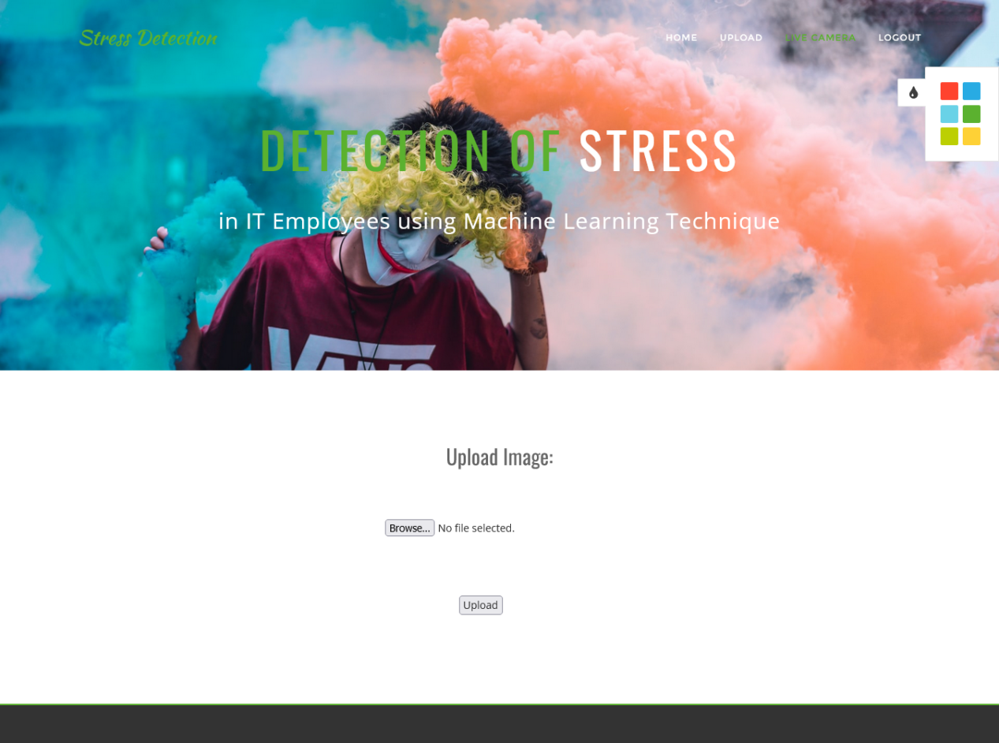

Slide 19
ADVANTAGES OF THE PROPOSED SYSTEM
The Stress Detection System helps workers in managing difficulties that add to stress by giving proactive stress management solutions.
In the proposed system the employee can also use a live cam to detect stress, which shows their emotional characteristic of them.
Stress Detection System enables employees to cope with their issues leading to stress by preventative stress management solutions.
The proposed system model has very High accuracy.
The proposed system automatically detects the important features without any human supervision.

Slide 20
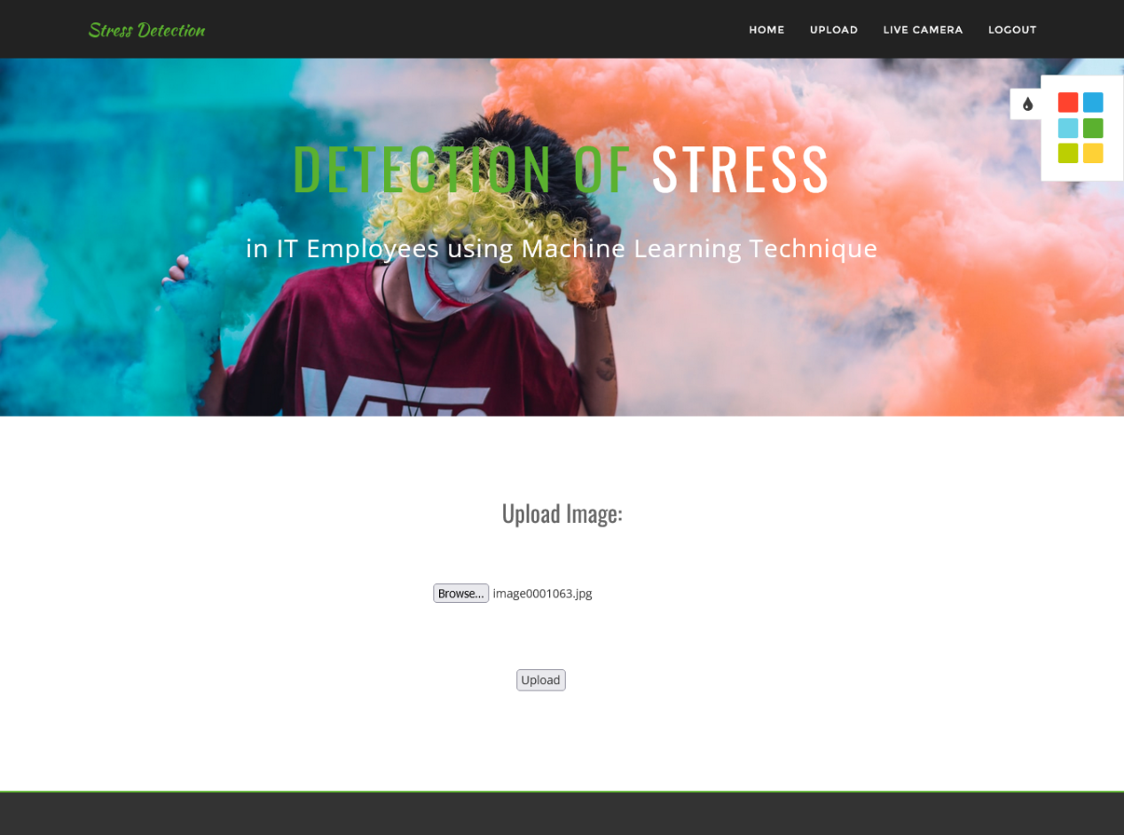

Slide 21
CNNs do not require human supervision for the task of identifying important features.
They are very accurate at image recognition and classification.
Weight sharing is another major advantage of CNNs.
Convolutional neural networks also minimize computation in comparison with a regular neural network.
CNNs make use of the same knowledge across all image locations.

Slide 22

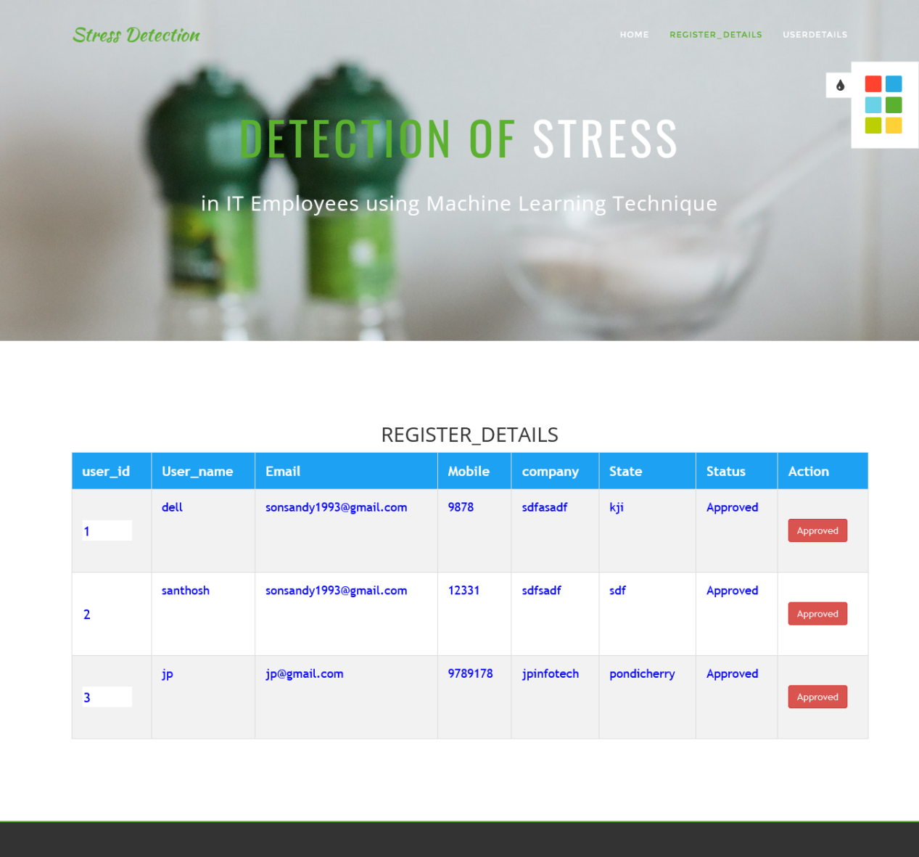

Slide 23

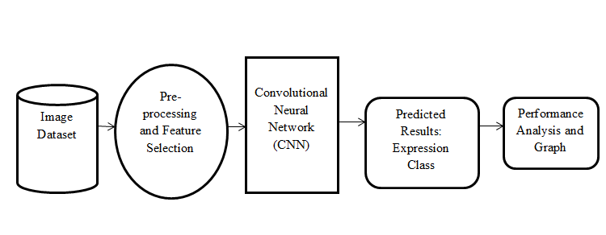
SYSTEM ARCHITECTURE

Slide 24
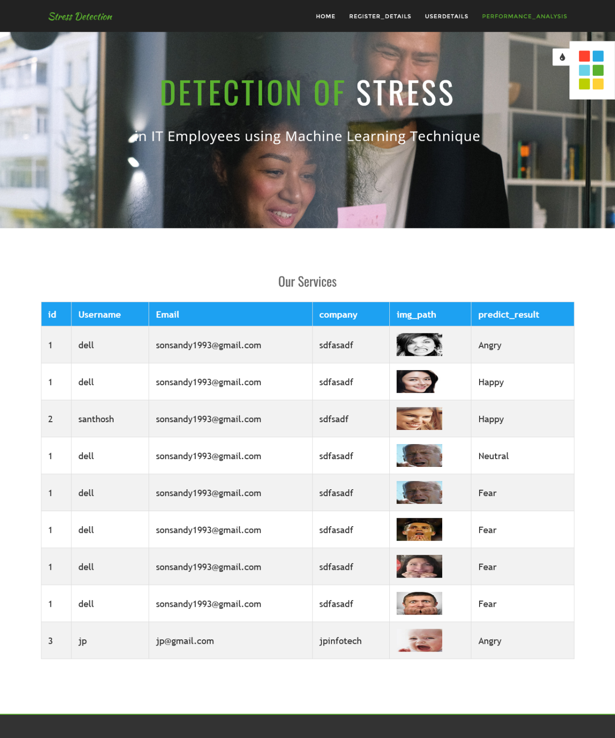

Slide 25

HARDWARE REQUIREMENTS
System : Pentium i3 Processor.
Hard Disk : 500 GB.
Monitor : 15’’ LED
Input Devices : Keyboard, Mouse
Ram : 4 GB

Slide 26
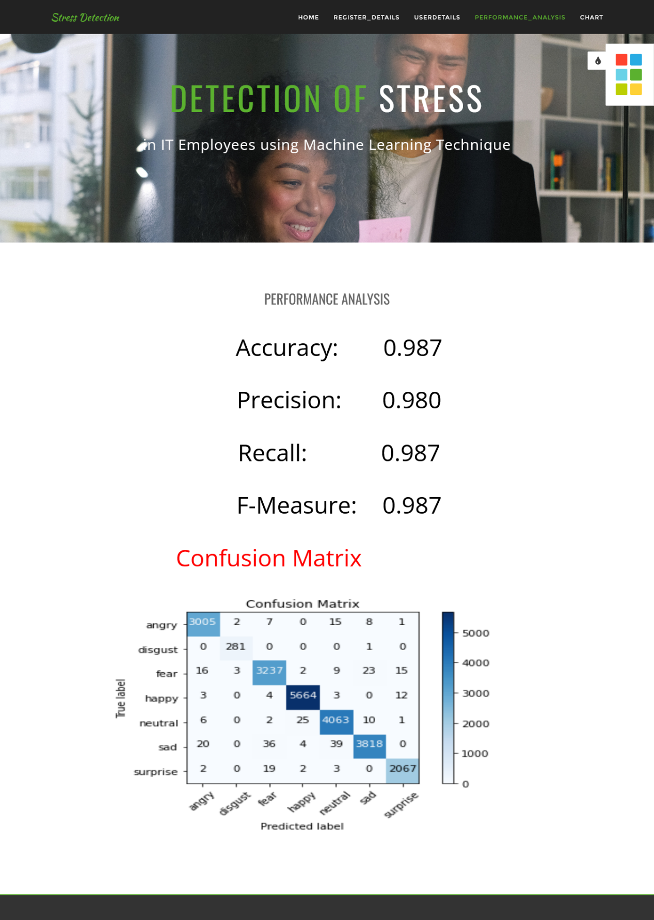

Slide 27

SOFTWARE REQUIREMENTS
Operating system : Windows 10.
Coding Language : Python
Web Framework : Flask
Database : MYSQL

Slide 28
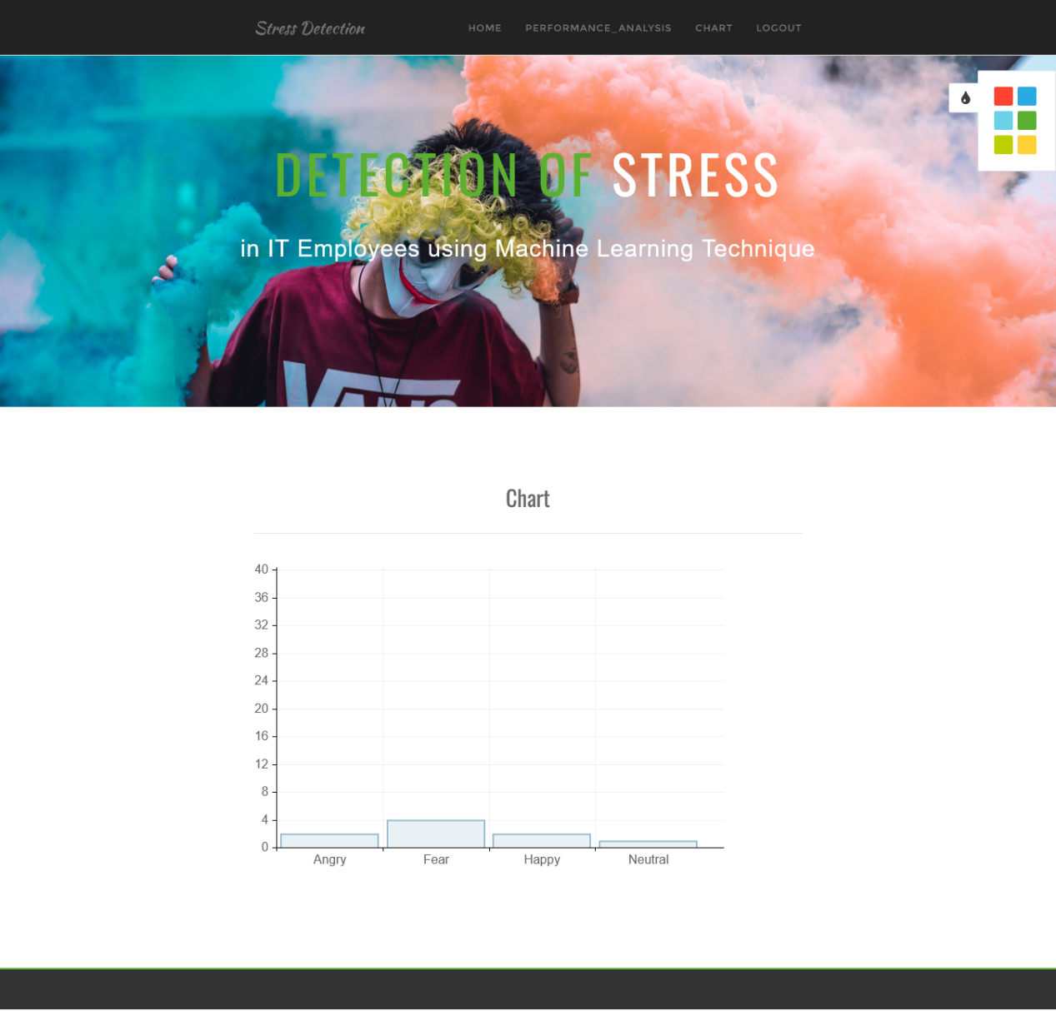

Slide 29
REFERENCE
Suresh Kumar Kanaparthi; Surekha P; Lakshmi Priya Bellamkonda; Bhavya Kadiam; Beulah Mungara, “Detection of Stress in IT Employees using Machine Learning Technique”, 2022 International Conference on Applied Artificial Intelligence and Computing (ICAAIC), IEEE Conference, 2022.

Slide 30



